Slide 1
Statistical Reasoning
PROBIDITA ROYCHOUDHURY
DEPT. OF COMPUTER SCIENCE
ST. ANTHONY’S COLLEGE

Slide 2
Uncertainty
Imperfection of human information
Information can be
  Incomplete
  Inconsistent
  Uncertain
Expert System should have the capability of handling uncertainty and drawing conclusions.

Slide 3
Sources of uncertain knowledge
Weak Implications
  Difficult to find concrete correlations of IF with THEN
Imprecise language
  Use of words like ‘ often’ , ‘sometimes’, etc.
Unknown Data
  Information is ‘unknown’
Combining views of various experts
  Experts may provide contradictory opinions and conclusions.

Slide 4
Ways of handling uncertainty
Bayesian Reasoning Method
Certainty Factors
Bayesian Network or Belief Network
Dempster Shafer Theory
Fuzzy Logic

Slide 5
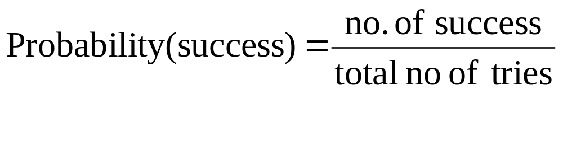
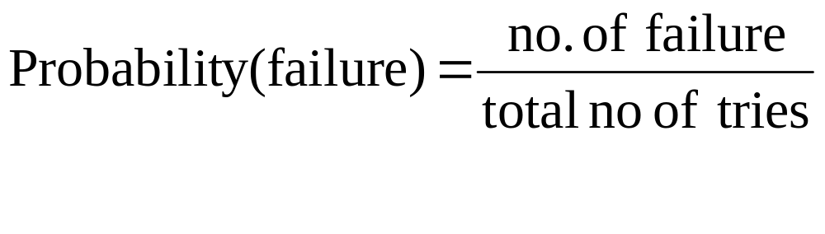
Basic Concepts of Probability

Slide 6
Basic Concepts of Probability
Probability always lies between 0 and 1.
Eg. Probability of getting a 6 in the first throw of a dice
p = 1/6 ; only 1 way of getting a 6 and total no. of possible outcomes
Probability of not getting a 6 in the first throw of a dice
q = 5/6 ; since there are 5 ways of not getting a 6 in a single throw

Slide 7
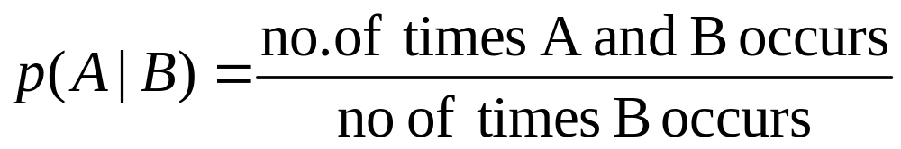
Conditional Probability
If A and B are events (not mutually exclusive), then the probability that the event A will occur if event B occurs is called conditional probability.
Denoted as p(A|B), read as A given B

Slide 8
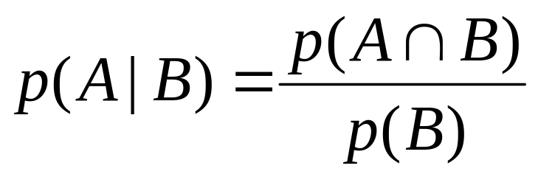
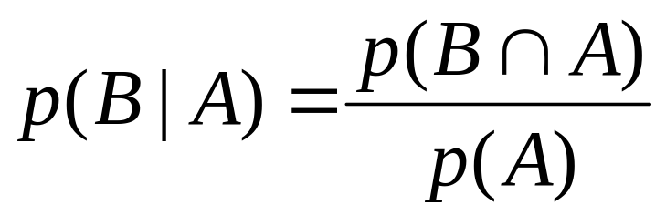
Joint Probability
The probability that both A and B occurs is called the joint probability of A and B,
Denoted by p(A ∩ B)

Slide 9
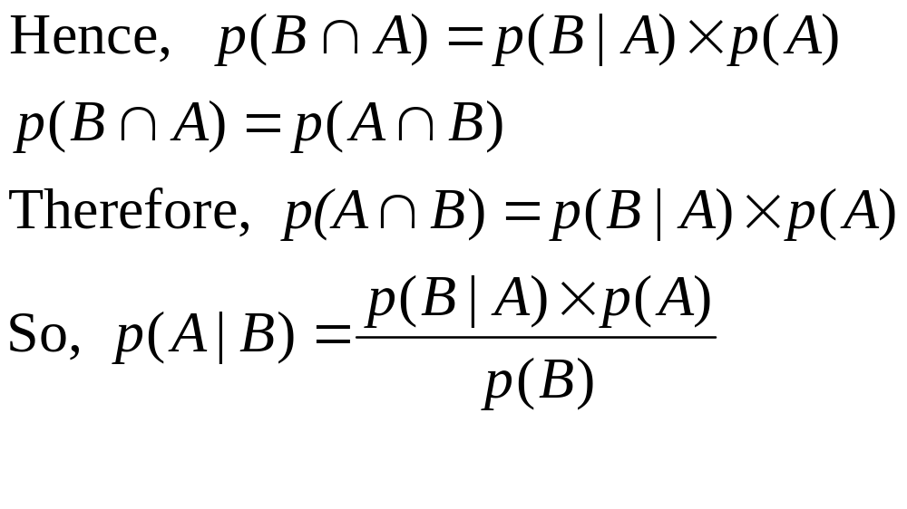
Commutative
------------------- (1)
The equation (1) is known as the Bayesian rule

Slide 10
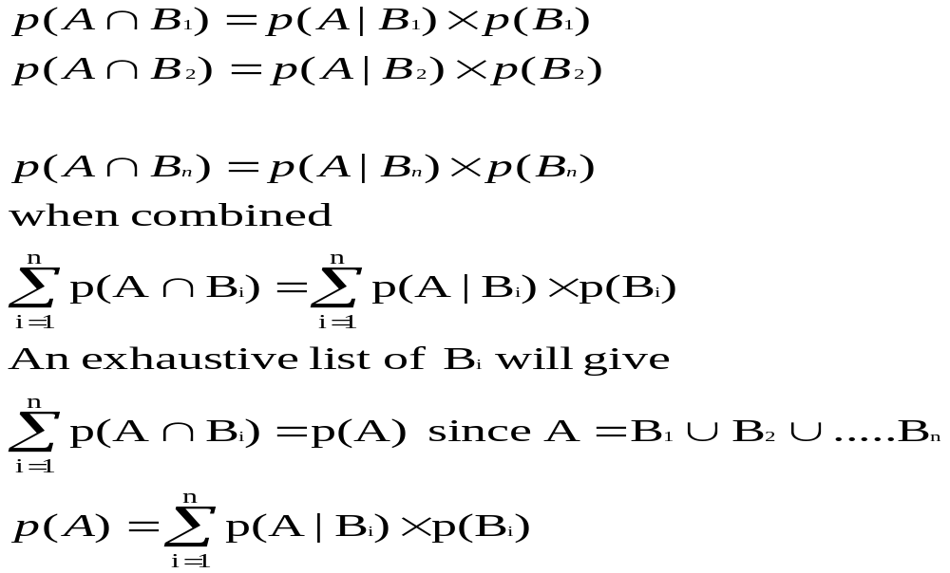
Let us extend this principle to a no. of mutually exclusive events B1,B2,…Bn. Then, we get

Slide 11
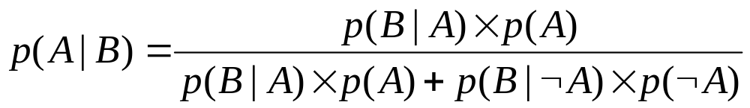
If the occurrence of event A depends on only two mutually exclusive events B and ∼B then
p(A)=p(A|B) × p(B) + p(A|∼B) × p(∼ B)
P(B)=p(B|A) × p(A) + p(B|∼A) × p(∼ A)
Hence,

Slide 12
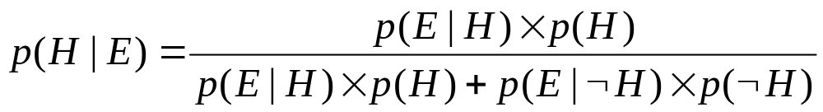
Bayesian Reasoning
Rules represented as
  IF E is true
  THEN H is true { with probability p }
  E : Evidence and H is the hypothesis
    p(H) : prior prob. of H being true
    p(E|H) : prob. that H is true will result in E
    p(~H) : prior prob. Of H being false
    p(E|~H) : prob. of E given H is false
Experts provides prior probabilities for H and ~H and p(E|H) and p(E|~H)
User provides information of the evidence observed.
Expert system computes the probability of H based on user evidence and prior probabilities.

Slide 13
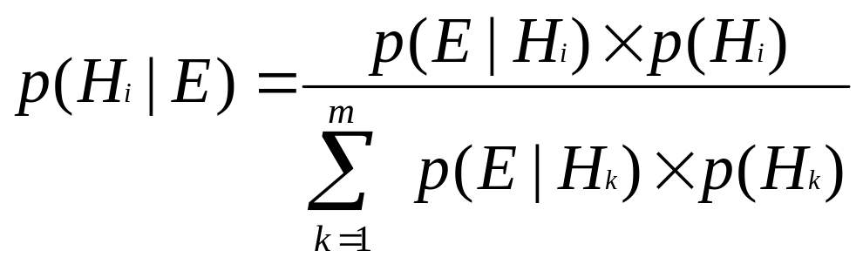
Bayesian Reasoning
We can also have situations where, based on single evidence we can get multiple hypothesis

Slide 14
An Example
P(patient-has-measles | patient-has-spots)
We know
  P(spots | measles) = 0.5
  P(spots | chickenpox) = 0.6
  P(spots | lassa) = 0.8
  P(measles) = 0.01
  P(chickenpox) = 0.01
  P(lassa) = 0.0005
P(m | s) = 0.5 x 0.01 / (0.5 x 0.01 + 0.6 x 0.01 + 0.8 x 0.0005) = 0.44

Slide 15
Example Continued
Bayes theorem is only valid if we know all the conditional probabilities relating to the evidence
  if there are hundreds of different diseases causing spots we'd need to know the probabilities of spots in each case
If we have multiple bits of evidence then things get more complex.
  The patient has a fever too
Impractical

Slide 16
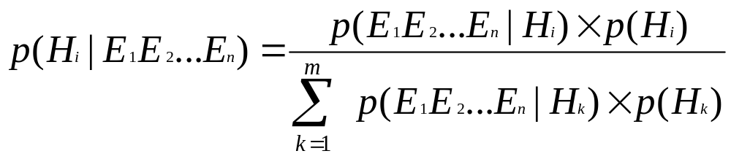
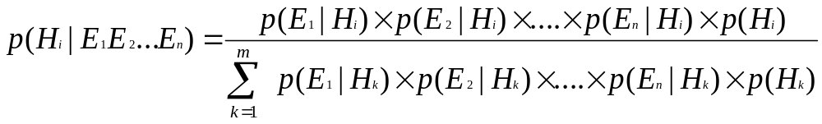
Bayesian Reasoning
Or, Given multiple evidences, we get multiple hypothesis
Enormous burden on experts, assume E1..En are independent

Slide 17
Example
Three conditionally independent evidences – E1, E2 and E3
Three mutually exclusive and exhaustive hypothesis – H1,H2 and H3
Given by experts
 | Hypothesis
Probability | i=1 | i=2 | i=3
p(H1) | 0.40 | 0.35 | 0.25
p(E1|Hi) | 0.3 | 0.8 | 0.5
p(E2|Hi) | 0.9 | 0.0 | 0.7
p(E3|Hi) | 0.6 | 0.7 | 0.9

Slide 18
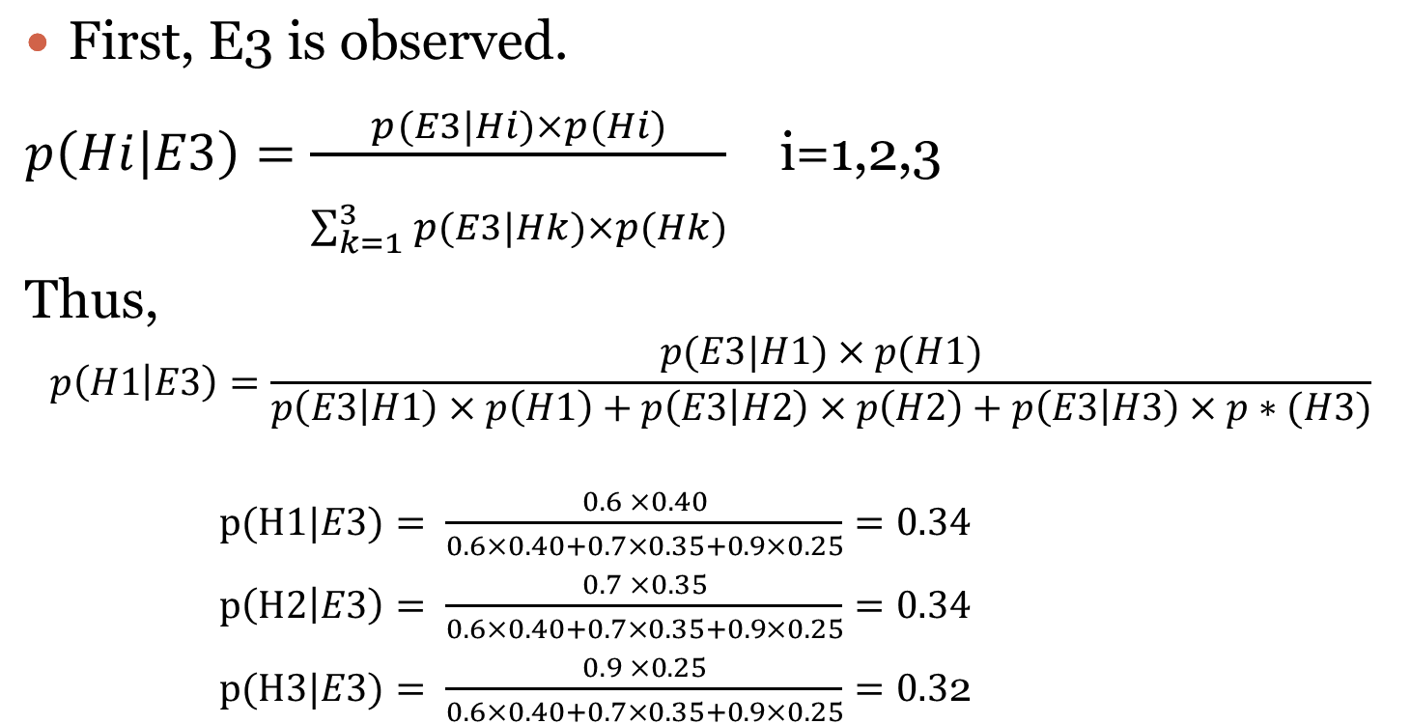
Example

Slide 19
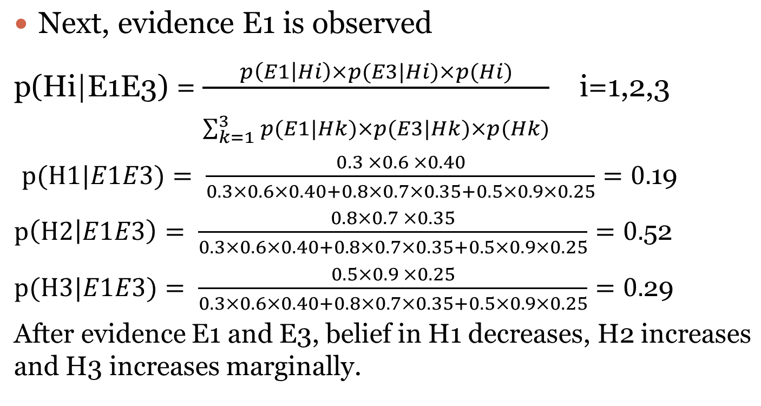
Example Contd.

Slide 20
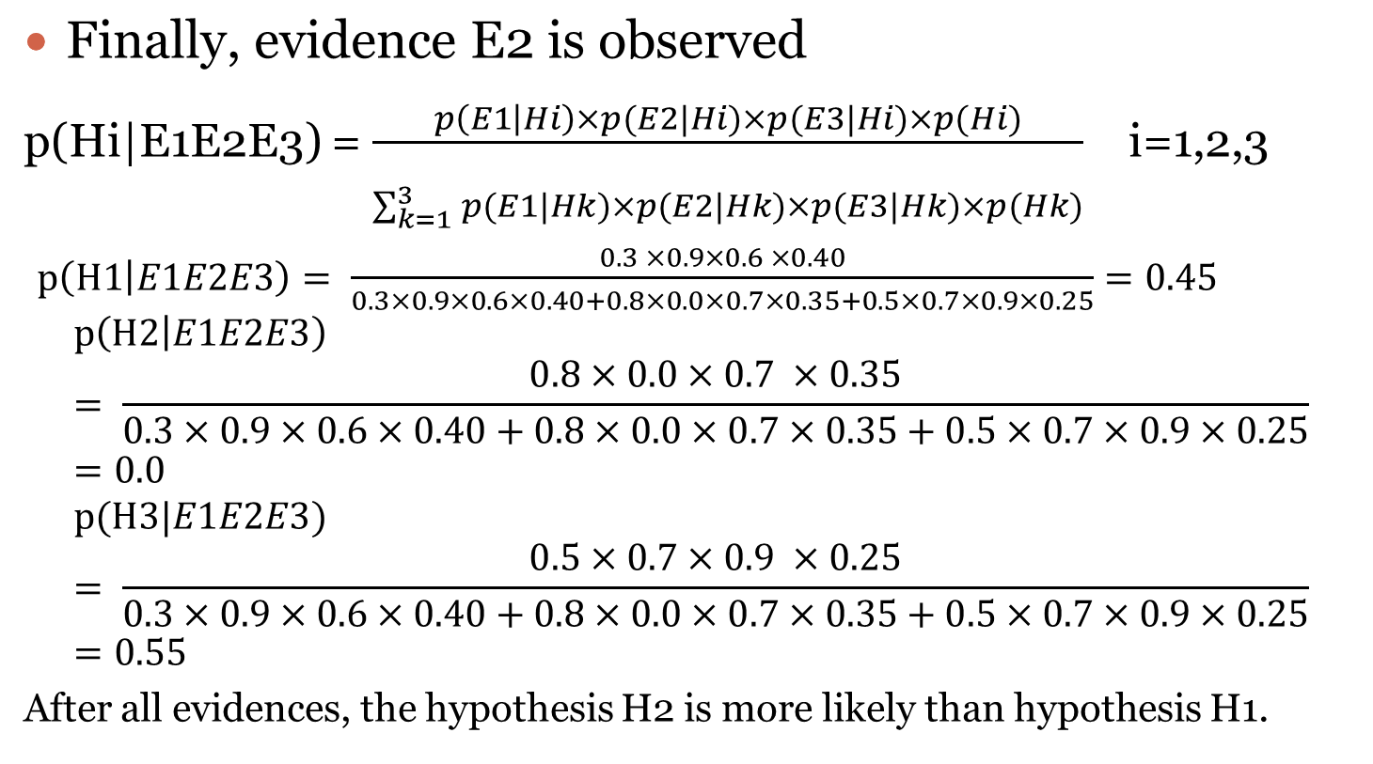
Example contd.

Slide 21
Mechanisms for uncertainty reasoning using Bayesian statistics
Attaching certainty factors to rules
Bayesian Networks
Dempster-Shafer Theory

Slide 22
Certainty Factors
A certainty factor (CF[h,e]) is defined in terms of two components –
  MB[h,e] : measure (between 0 and 1) of belief in hypothesis h given that evidence e.
  MD[h,e] : measure (between 0 and 1) of disbelief in hypothesis h given the evidence e
  CF[h,e] = MB[h,e] – MD[h,e]

Slide 23
Uncertain Terms Interpretation
Term | Certainty factor
Definitely Not | -1.0
Almost certainly not | -0.8
Probably not | -0.6
Maybe not | -0.4
Unknown | -0.2 to +0.2
Maybe | +0.4
Probably | +0.6
Almost certainly | +0.8
Definitely | +1.0

Slide 24
Definition of CF
The above definitions had some difficulties.
  For example, ten pieces of evidence might produce a MB = 0.999 and one disconfirming piece with MD = 0.799 could then give
CF = 0.999 - 0.799 = 0.200
This definition was later changed to
CF[h,e]=(MB – MD)/[1 - min(MB, MD)]
Under this definition
CF=(0.999-0.799)/(1- min(0.999, 0.799)) = 0.995

Slide 25
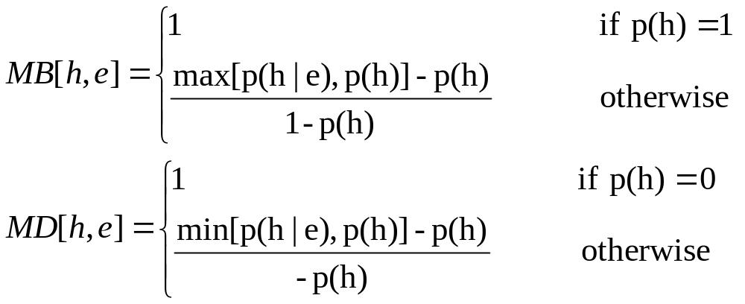
MD and MB in terms of probability

Slide 26
Certainty Factors
CF values for rules are provided by experts which reflect their assessment of the strength of the evidences in support of the hypothesis.
For example,
    IF has-spots(X)
    AND has-fever(X)
    THEN has-measles(X) CF 0.5

Slide 27
Characteristics Values
-------------------------------------------------------------
Ranges 0 ≤ MB ≤ 1
0 ≤ MD ≤ 1
-1 ≤ CF ≤ 1
------------------------------------------------------------
Certain True Hypothesis MB =1
P(H | E) = 1 MD =0
CF = 1
-------------------------------------------------------
Certain False Hypothesis MB =0
P(H’|E) =1 MD =1
CF = -1
-------------------------------------------------------
Lack of evidence MB = 0
P(H | E) = P(H) MD = 0
CF =0

Slide 28
Single Antecedent Rule
The net certainty for a single antecedent rule cf(H,E) is
    cf(H,E) = cf(E) × cf ,
    where cf(E) is certainty factor of antecedent
    cf is certainty factor of rule
  For example,
  IF has-spots(X) THEN has-measles(X) CF 0.8
    cf(has-spots)=0.5,
    cf(E) = 0.5 and cf =0.8
    Therefore, cf(H,E) = 0.5 x 0.8 =0.45

Slide 29
Rules with multiple evidences
Case I
  IF E1 and E2 and …En THEN H { cf }
cf(H|E1 & E2 & …En) = min[cf(E1),cf(E2)…cf(En)] x cf
For example,
If sky is clear and the forecast is sunny then ‘wear sunglasses’ { cf 0.8}
cf(sky is clear)=0.9 and cf(forecast is sunny)=0.7
cf(H|E1 & E2) = min(0.9,0.7)* 0.8 = 0.7 * 0.8 = 0.56

Slide 30
Rules with multiple evidences
Case II
  IF E1 or E2 or …En THEN H { cf }
cf(H|E1 & E2 & …En) = max[cf(E1),cf(E2)…cf(En)] x cf
For example,
If sky is overcast or the forecast is rain then ‘take umbrella’ { cf 0.9}
cf(sky is overcast)=0.6 and cf(forecast is rain)=0.8
cf(H|E1 || E2) = max(0.6,0.8)* 0.9 = 0.8 * 0.9 = 0.72

Slide 31
Combining evidences
-------------------------------------------------------------
Evidence, E Antecedent Certainty
-------------------------------------------------------------
E₁ AND E₂ min [CF(E₁, e),CF(E₂, e)]
E₁ OR E₂ max[CF(E₁, e),CF(E₂, e)]
NOT E -CF(E, e)
--------------------------------------------------------------

Slide 32
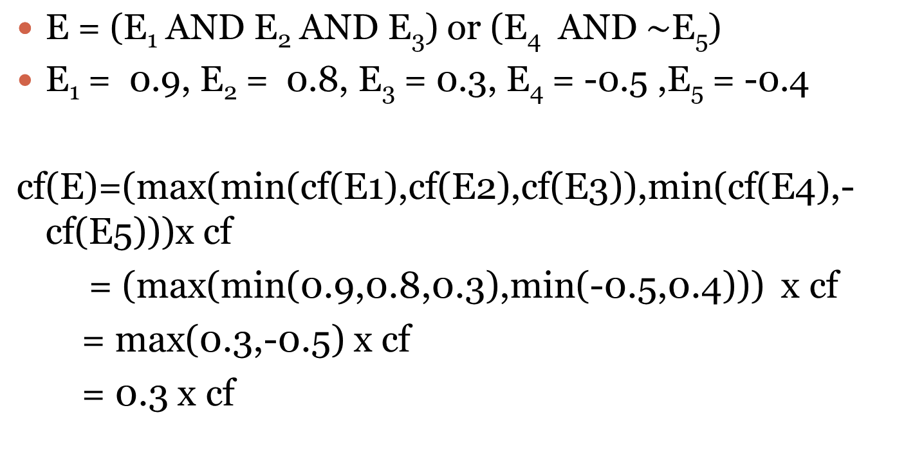
Example

Slide 33
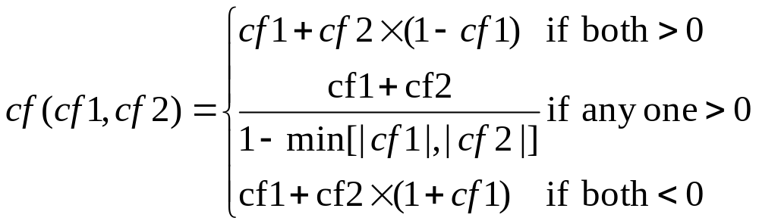
Multiple rules affect same hypothesis
Rule 1 : IF A is X THEN C is Z {cf 0.8}
Rule 2 : IF B is Y THEN C is Z {cf 0.6}
cf1,cf2 are the certainty factors from rule 1 and rule 2 respectively.

Slide 34
Let cf(E1)=cf(E2)=1, then
cf1(H,E1)= cf(E1) * cf1 = 1.0 * 0.8 =0.8
cf2(H,E2)=cf(E2) * cf2 = 1.0 * 0.6 =0.6
cf(cf1,cf2) = cf1(H,E1) + cf2(H,E2) x [1-cf1(H,E1)]
= 0.8 + 0.6 x (1-0.8) =0.92
Shows an incremental increase in belief in a hypothesis

Slide 35
Let cf(E1)=1, cf(E2)=-1, then
cf1(H,E1)= cf(E1) * cf1 = 1.0 * 0.8 =0.8
cf2(H,E2)=cf(E2) * cf2 = -1.0 * 0.6 =-0.6
cf(cf1,cf2) = [cf1(H,E1) + cf2(H,E2)]/ [1-min(|cf1(H,E1)|,|cf2(H,E2)|)]
= [0.8 - 0.6]/[1-min(0.8,0.6)]
= 0.2/0.4 = 0.5

Slide 36
Let cf(E1)=cf(E2)=-1, then
cf1(H,E1)= cf(E1) * cf1 = -1.0 * 0.8=-0.8
cf2(H,E2)=cf(E2) * cf2 = -1.0 * 0.6 =-0.6
cf(cf1,cf2) = cf1(H,E1) + cf2(H,E2) x [1+cf1(H,E)]
= -0.8 + (-0.6) * [1+(-0.8)]
= -0.8 – 0.12
=-0.92

Slide 37
Example
Rule 1
IF the weatherman says it is going to rain (E1)
THEN It is going to rain (H)
CF (Rule 1) = 0.8
Rule 2
IF the farmer says it is going to rain (E2)
THEN It is going to rain (H)
CF (Rule 2) = 0.8

Slide 38
Certainty Factor Propagation (C.F.P)
Example
Consider Rain Prediction: Rule 1 and 2
Explore several cases
Case 1: Weatherman and Farmer Certain in Rain
CF (E1) = CF (E2) = 1.0
CF1 (H, E1) = CF (E1) * CF (RULE 1)
C.F.P.
= 1.0 * 0.8 = 0.8 for
single
CF2 (H, E2) =CF (E2) * CF (RULE 2) Premise
Rule
= 1. 0 * 0.8 = 0.8

Slide 39
Certainty Factor Propagation (C.F.P)
Since both > 0,
CF_{combine} (CF1, CF2) = CF1 + CF2 * (1 - CF1)
= 0.8 + 0.8 * (1 - 0.8)
  = 0.96 #
CF supported by > 1 rule can be incrementally increase
more confident

Slide 40
Certainty Factor Propagation (C.F.P)
Case 2: Weatherman certain in rain, Farmer certain no rain
CF (E1) = 1.0 CF (E2) = -1.0
CF1 (H, E1) = CF (E1) * CF (RULE 1)
= 1.0 * 0.8 = 0.8
CF2 (H, E2) = CF (E2) * CF (RULE 2)
= -1.0 * 0.8 = -0.8
Since either one < 0
CF_{combined} (CF1, CF2) = CF1 + CF2
1 - min {|CF1|,|CF2|}
= 0.8 + (-0.8)
1 - min {0.8,0.8}
= 0 #
CF set to unknown because one say “no” and the other one say “yes”

Slide 41
Certainty Factor Propagation (C.F.P)
Case 3: Weatherman and Farmer believe at different degrees that it is going to rain
CF (E1) = -0.8 CF (E2) = -0.6
CF1 (H, E1) = CF (E1) * CF (RULE 1)
= -0.8 x 0.8
= -0.64
CF2 (H, E2) = CF (E2) * CF (RULE 2)
= -0.6 * 0.8
= -0.48
Since both < 0
CF_{combined} (CF1, CF2) = CF1 + CF2 * (1 + CF1)
= - 0.64 - 0.48 * (1 - 0.64)
= -0.81 #
Show incremental decrease when more than one source disconfirming evidence is found

Slide 42
Certainty Factor Propagation (C.F.P)
Case 4: Several Sources Predict Rain at the same level of belief but one source
predicts no rain
If many sources predict rain at the same level, CF(Rain) = 0.8, the CF value
converge towards 1
CF_{combined} (CF1, CF2 ..) 0.999 = CF_{old}
CF_{old} = collected old sources info.
If new source say negative
CF_{new} = -0.8
then,
CF_{combined} (CF_{old}, CF_{new})
= CF_{old} + CF_{new}
1 - min { CF_{old}, CF_{new} }
= 0.999-0.8
1 - 0.8
= 0.995
Shows single disconfirming evidence does not have major impact

Slide 43
Bayesian Networks
Most events are conditionally independent of each other, so interactions may not be considered.
Network notation on various kinds of constraints on likelihood.
Entities are represented as nodes of a DAG.
Directed arcs denotes the dependency of one entity on the other.

Slide 44
Example
If the sprinkler was on last night then the grass will be wet this morning.
If the grass is wet this morning then it rained last night.
Sprinkler
Rain
Wet

Slide 45
Bayesian Networks
The network is constructed such that given its parents, a node is conditionally independent of the rest of the variables.
That is
P(X1=x1, ..., Xn=xn) = P(xi | Parents(Xi)) * ... * P(xn | Parents(Xn))

Slide 46
Example
The following information is given
  When my wife leaves the house, she often (but not always) turns on the outside light. (She also sometimes turns the light on when she's expecting a guest.)
  When nobody is home, the dog is often left outside.
  If the dog has bowel-troubles, it is also often left outside.
  If the dog is outside, I will probably hear it barking (though it might not bark, or I might hear a different dog barking and think it's my dog).

Slide 47
Boolean Variables
O: Everyone is Out of the house
L: The Light is on
D: The Dog is outside
B: The dog has Bowel troubles
H: I can Hear the dog barking

Slide 48
Example contd.
We can arrive at these dependencies
  H is only directly influenced by D. Hence H is conditionally independent of L, O and B given D.
  D is only directly influenced by O and B. Hence D is conditionally independent of L given O and B.
  L is only directly influenced by O. Hence L is conditionally independent of D, H and B given O.
  O and B are independent.

Slide 49
Bayesian Network
O
B
L
D
H

Slide 50
Bayesian Network with associated probabilities
p(O)=0.6
O
B
P(B)=0.3
L
D
p(D|O,B)=0.05
p(D|O,~B)=0.1
p(D|~O,B)=0.1
p(D|~O,~B)=0.2
p(L|O)=0.3
p(L|~O)=0.6
H
Need only 10 probabilities instead of 2⁵=32 probabilities
P(H|D)=0.3
P(H|~D)=0.8

Slide 51
Computing Joint Probabilities from a Bayesian Network
Goal: Compute P(B,~O,D,~L,H)
P(B,~O,D,~L,H) = P(H,~L,D,~O,B)
= P(H | ~L,D,~O,B) * P(~L,D,~O,B)
= P(H|D) * P(~L,D,~O,B)
= P(H|D) P(~L | D,~O,B) P(D,~O,B)
=P(H|D) P(~L|~O) P(D,~O,B)
= P(H|D) P(~L|~O) P(D | ~O,B) P(~O,B)
= P(H|D) P(~L|~O) P(D|~O,B) P(~O | B) P(B)
= P(H|D) P(~L|~O) P(D|~O,B) P(~O) P(B)
= (.3)(1 - .6)(.1)(1 - .6)(.3) = 0.00144

Slide 52
Algorithm for creating BN
Identify a set of random variables that describe the given problem domain
Choose an ordering for them: X1, ..., Xn
for i=1 to n do
  Add a new node for Xi to the net
  Set Parents(Xi) to be the minimal set of already added nodes such that we have conditional independence of Xi and all other members of {X1, ..., Xi-1} given Parents(Xi)
  Add a directed arc from each node in Parents(Xi) to Xi
  If Xi has at least one parent, then define a conditional probability table at Xi: P(Xi=x | possible assignments to Parents(Xi)). Otherwise, define a prior probability at Xi: P(Xi)

Slide 53
Mr. Holmes has a burglar alarm in his house.
If the alarm sounds then Eric (Mr. Holme’s neighbor) calls him up.
Another neighbour, Cynthia, also calls on hearing the alarm. (Cynthia has loud music playing, so she sometimes mistakes the arlarm).
If the alarm sounds then there may be a burglary.
Sometimes, the alarm is also set on by earthquakes.
A newscast confirms when there is an earthquake.

Slide 54
Dempster-Shafer Theory
Evolved during the 1960s and 1970s through the efforts of Arthur Dempster and one of his students, Glenn Shafer.
Tries to model uncertainty as a range of probabilities rather than a single probabilistic number
Probability theory is not able to distinguish between uncertainty and ignorance owing to incomplete information.

Slide 55
Environment
Given a set of possible elements (finite), called environment,
Θ = {θ₁, θ₂, ..., θ_{n}}
that are mutually exclusive and exhaustive.
The environment is the set of objects that are of interest to us ( universal set of set theory)
For example
= {red, green, blue, orange, yellow}

Slide 56
Question and Answer
One way of thinking about Θ is in terms of questions and answers. Suppose
Θ = {airline, bomber, fighter}
and the questions is, “Which are the military aircraft?”
The answer is the subset of Θ
{θ₂, θ₃} = {bomber, fighter}
An answer to a question can be a subset of Θ

Slide 57
More about subsets of Θ
There can be only one answer subset to a question.
An environment is also called a frame of discernment, as it is possible to distinguish the one correct answer from all the other possible answers to a question.
If this is not possible then the environment must be expanded.
All answers to possible questions of the frame of discernment is given by the power set of Θ

Slide 58
Mass Functions
In Dempster-Shafer theory we refer to the degree of belief in evidence as analogous to the mass of a physical object.
The reason for the analogy with an object of mass is to consider belief as a quantity that can move around, be split up, and combined.

Slide 59
Ignorance
In absence of prior knowledge, we consider the probability of each occurrence as
P=1/N
And P(A)+P(A’)=1
The Dempster-Shafer theory does not force belief to be assigned to ignorance or refutation of a hypothesis.
The mass is assigned only to those subsets of the environment to which you wish to assign belief.

Slide 60
Ignorance contd.
Any belief that is not assigned to a specific subset is considered no belief or nonbelief and just associated with environment Θ.
Belief that refutes a hypothesis is disbelief, which is not nonbelief.

Slide 61
Example
For example, we are trying to identify whether an aircraft is hostile. Suppose there is the evidence of 0.7 indicating a belief that the target aircraft is hostile, where hostile aircraft are only considered to be bombers and fighters. Thus, the mass assignment is to the subset {bomber, fighter), and
m₁({bomber, fighter}) = 0.7
The rest of the belief is left with the environment, Θ, as nonbelief.
m₁(Θ) = 1- 0.7 = 0.3.

Slide 62
Example contd.
The Dempster-Shafer theory has a major difference with probability theory which would assume that
P(hostile) = 0.7
P(non-hostile) = 1 - 0.7 = 0.3
0.3 in Dempster-Shafer theory is held as nonbelief in the environment by m(Θ). This means neither belief nor disbelief in the evidence to a degree of 0.3.

Slide 63
Mass Assignment Function
Let Θ be a frame of discernment (environment). A mass assignment function assigns a number m(x) to each x ⊆ Θ such that:
(1) 1 ≥ m(x) ≥ 0
(2) m(∅) = 0
(3) ∑ m(x) = 1

Slide 64
Focal Element and Core
Let Θ be a frame of discernment (environment). and let m be a mass assignment function on Θ.
A set x ⊆ Θ is called a focal element in m if m(x) >= 0. The core of m, denoted by k(m), is the set of all focal elements in m.

Slide 65
Example
Θ = {heart-attack, pericarditis, pulmonary-embolism, aortic-dissection}.
No. of possible subsets = 16
No. of mass assignments = 16
If for a specific patient there is no evidence pointing at a certain diagnosis in particular, the mass of 1 is assigned to Θ.
1 if x = Θ
m₀(x) =
0 otherwise

Slide 66
Each proper subset of Θ gets assigned the number 0. The core of m₀ is equal to {Θ}
Now suppose that some evidence has become available that points to the composite hypothesis heart-attack or pericarditis with some certainty.
Then the subset {heart-attack, pericarditis} will be assigned a mass, e.g., 0.4. Due to lack of further information, the remaining certainty 0.6 is assigned to Θ.
0.6 if x = Θ
m₁(x) = 0.4 if x = {heart-attack, pericarditis}
0 otherwise

Slide 67
Now suppose we have obtained some evidence against the hypothesis that our patient is suffering from pericarditis. This information can be considered as support for hypothesis that the patient is not suffering from pericarditis. This is equivalent to the composite hypothesis heart-attack or pulmonary-embolism or aortic-dissection. We therefore assign a mass, for example 0.7, to the set {heart-attack, pulmonary-embolism, aortic-dissection}
0.3 if x = Θ
m₂(x) = 0.7 if x = {heart-attack, pulmonary-embolism, aortic-dissection }
0 otherwise

Slide 68
Combining Evidence
Computing from two pieces of evidence and their associated masses, the combined influence of these pieces of evidence.
Let m₁ and m₂ be mass assignments on Θ, the frame of discernment. The combined mass is computed using the formula (special form of Dempster’s rule of Combination)
m₁ ⊕ m₂(Z) = ∑ m₁(X) m₂(Y)
X ∩Y= Z

Slide 69
Let Θ = {B,A,F} and m1 and m2 be two mass assignment functions.
m1({B,F})=0.7 , m1(Θ)=0.3 and
m2({B})=0.9 , m2(Θ) = 0.1
m3({B})=m1 ⊕ m2({B}) = 0.63 +0.27 = 0.90
m3({B,F})=m1 ⊕ m2({B,F}) = 0.07 = 0.07
m3(Θ) = m1 ⊕ m2(Θ) = 0.03
 | m2({B})=0.9 | m2({Θ })=0.1
m1({B,F})=0.7 | {B} 0.63 | {B,F} 0.07
m1({Θ })=0.3 | {B} 0.27 | Θ 0.03

Slide 70
Example condt.
The m₃({B}) represents the belief that the target is a bomber and only a bomber.
m₃({B, F}) and m₃(Θ) imply more information as their sets include a bomber, it is plausible that their sums may contribute to a belief in the bomber.
So 0.07 + 0.03 = 0.1 may be added to the belief of 0.9 in the bomber set to yield the maximum belief (= 1) that it could be a bomber. This is called the plausible belief.

Slide 71
Support and Plausibility
We have two belief values for the bomber, 0.9 and 1. This pair represents a range of belief. It is called an evidential interval.
The lower bound is called the support (Spt) or Bel, and the upper bound is called plausibility (PIs).
The support is the minimum belief based on the evidence, while the plausibility is the maximum belief we are willing to give.

Slide 72
Support and Plausibility
Thus, 0 ≤ Bel ≤ PIs ≤ 1
Evidential Interval Meaning
--------------------------------------------------------------------------
[1, 1] Completely true
[0, 0] Completely false
[0, 1] Completely ignorant
[Bel, 1] where 0 < Bel < 1 Tends to support
[0, PIs] where 0 < PIs < 1 Tends to refute
[Bel, PIs] where 0 < Bel ≤PIs < 1 Tends to both support and refute

Slide 73
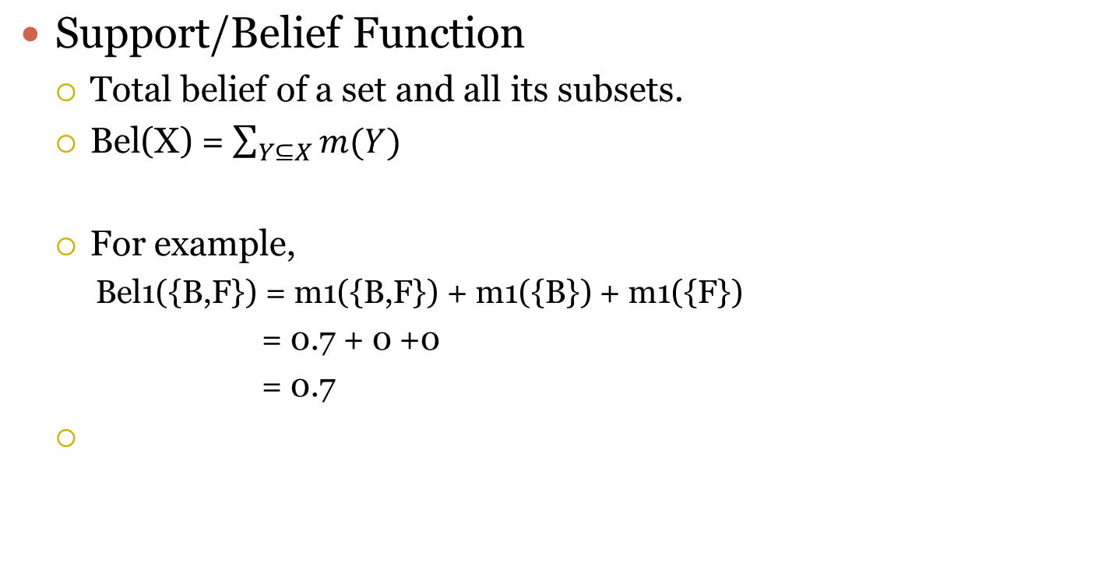
Belief Function

Slide 74
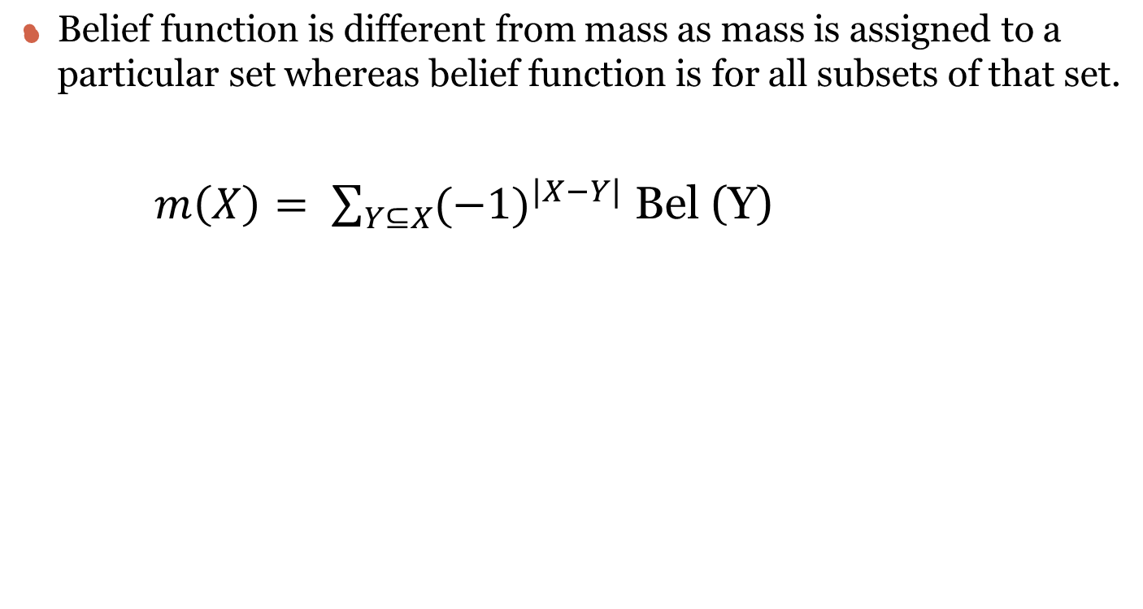
Mass and Belief function

Slide 75
Combination of Belief Functions
The combination of two belief functions can be expressed as the orthogonal sums of the masses of a set and all its subsets.
Example,
  Bel1 ⊕ Bel 2 ({B}) = m1 ⊕ m2 ({B}) + m1 ⊕ m2 (∅) = 0.90 + 0 = 0.90
  Bel1 ⊕ Bel 2 ({B,F})
  = m1 ⊕ m2 ({B}) + m1 ⊕ m2 ({B,F}) + m1 ⊕ m2 ({F}) + m1 ⊕ m2 (∅)
  = 0.07 + 0.90 + 0 + 0 = 0.97
  Bel1 ⊕ Bel 2 (Θ)
  = m1 ⊕ m2 (Θ) + m1 ⊕ m2 ({B,F}) + m1 ⊕ m2 ({F}) + m1 ⊕ m2 (∅)
  = 0.03 +0.07 +0.90 + 0 = 1

Slide 76
Evidential Interval
The evidential interval can be defined in terms of belief of a set
EI(S) = [ Bel(S), 1-Bel(S’)]
Example,
If S={B} then S’ = {A,F}
  Bel1 ⊕ Bel 2 ({A,F})
  = m1 ⊕ m2 ({A,F}) + m1 ⊕ m2 ({A}) + m1 ⊕ m2 ({F}) + m1 ⊕ m2 (∅) = 0 + 0 + 0 + 0 =0
  EI({B}) = [Bel({B} , 1-Bel({A,F})]
  = [0.90 , 1]

Slide 77
Evidential Interval
The EI of [total belief , plausibility] can be expressed as
[ evidence for support, evidence for support+ ignorance]

Slide 78
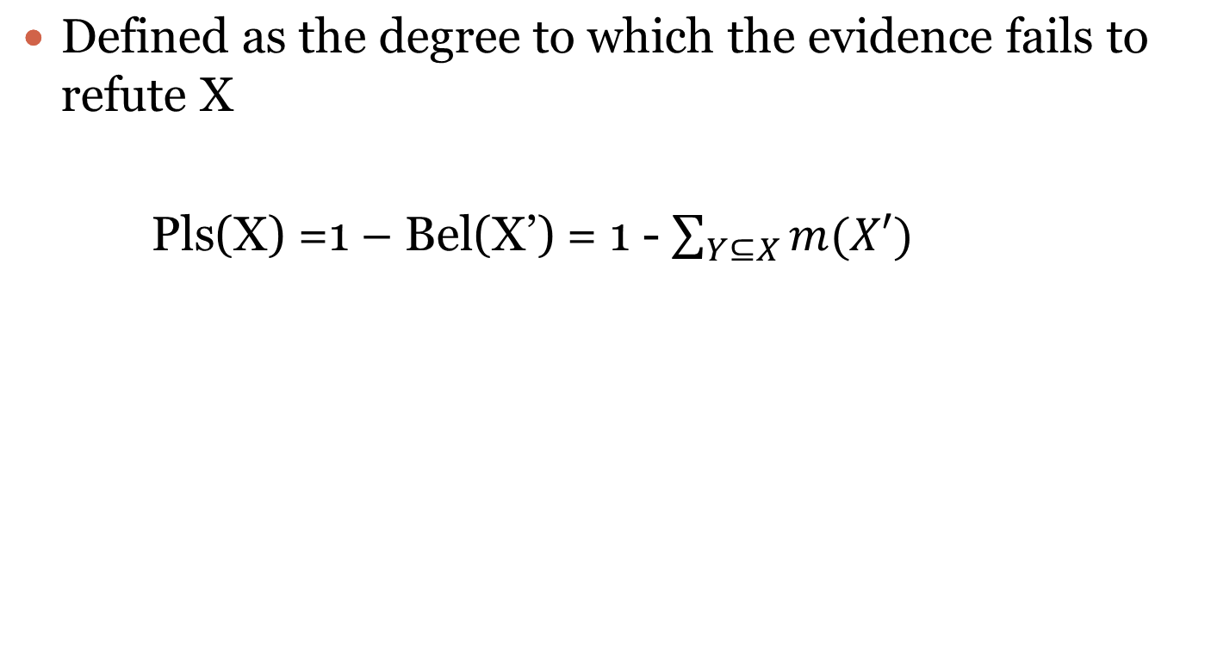
Plausibility Function

Slide 79
Normalization of Belief
In the example with the airline, fighter and bomber, consider a third sensor providing evidence of an airliner.
m3({A}) = 0.95 and m3(Θ) = 0.05
 | m1⊕m2({B})=0.90 | m1⊕m2({B,F})=0.07 | m1⊕m2(Θ)= 0.03
m3({A}) = 0.95 | 0 | ∅ 0 | {A} = 0.0285
m3(Θ) =0.05 | {B} 0.045 | {B,F} 0.0035 | Θ 0.0015

Slide 80
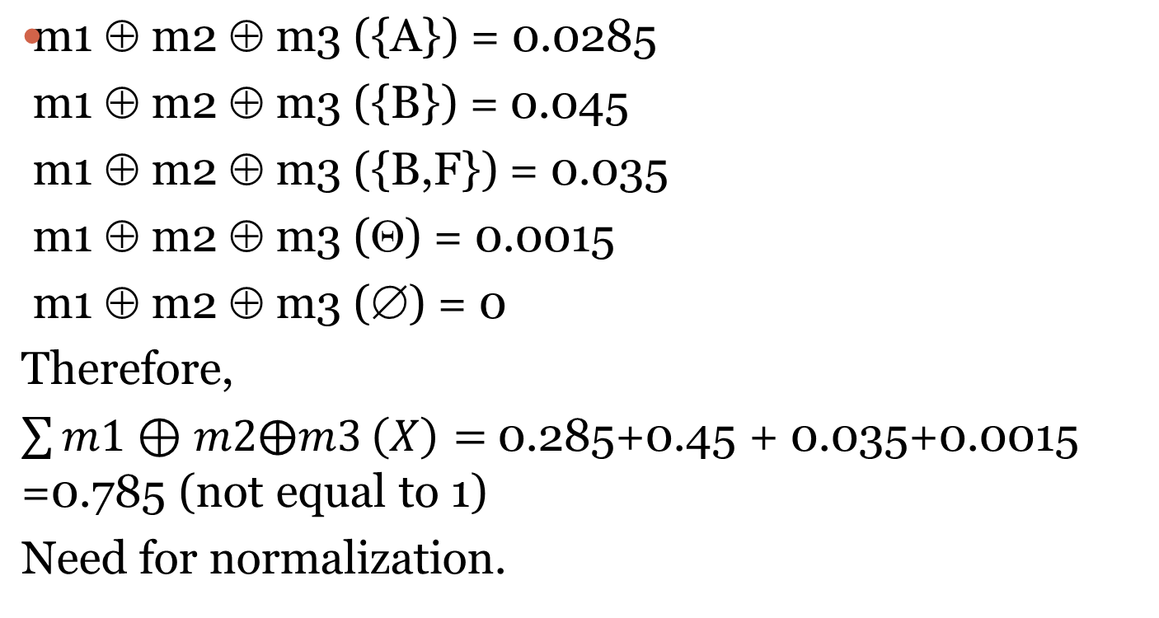

Slide 81
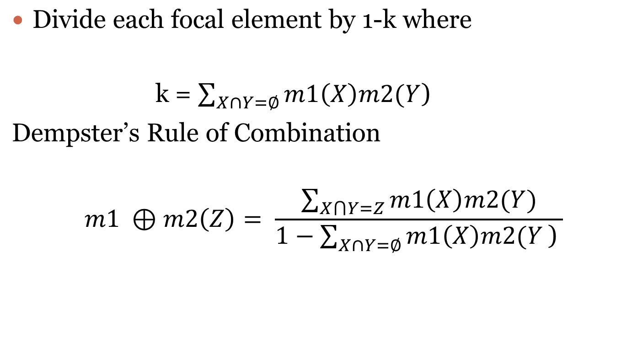
Normalization

Slide 82
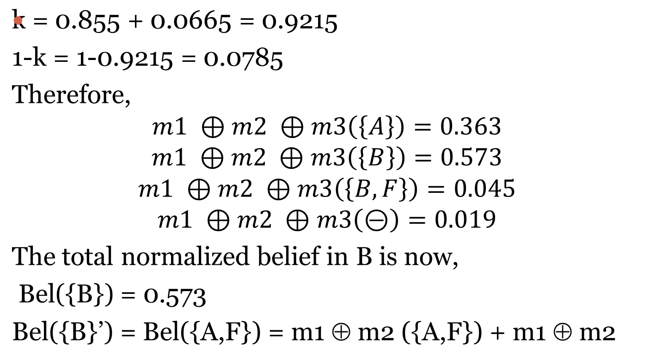

Slide 83
Fuzzy Logic
Boolean Logic used two-state logic i.e true or false, 0 or 1
Fuzzy logic is a superset of BL which is extended to include ‘partial truth’ i.e truth values between completely true and completely false

Slide 84
Fuzzy Sets
Crisp Sets
  A set to which an object either belongs or does not belong.
  Characteristic/Membership function
    μ _{A}(x) : X → {0,1}
Fuzzy Sets
  A set to which an object might belong to partially or to a certain degree.
  Characteristic /Membership function
  μ _{A}(x) : X → [0,1]

Slide 85
Example
Consider a crisp set A of elements representing the age of people
A = {2,4,10,15,21,30,35,40, 45, 60,70}
Let’s classify age as – infant, child, adolescent, adult, young and old.
These are termed as fuzzy quantifiers.
Problem is how to classify a person who is, say, 30 – young or old or adult?

Slide 86
One way is to represent the ages as follows.
Age | Infant | Child | Adols. | Young | Adult | Old
2 | 1 | 0 | 0 | 1 | 0 | 0
4 | 0.1 | 0.5 | 0 | 1 | 0 | 0
10 | 0 | 1 | 0.3 | 1 | 0 | 0
15 | 0 | 0.8 | 1 | 1 | 0 | 0
21 | 0 | 0 | 0.1 | 1 | 0.8 | 0.1
30 | 0 | 0 | 0 | 0.6 | 1 | 0.3
35 | 0 | 0 | 0 | 0.5 | 1 | 0.35
40 | 0 | 0 | 0 | 0.4 | 1 | 0.4
45 | 0 | 0 | 0 | 0.2 | 1 | 0.6
60 | 0 | 0 | 0 | 0 | 1 | 0.8
70 | 0 | 0 | 0 | 0 | 1 | 1

Slide 87
Some common Terms
Universe of Discourse (U)
  Range of all possible values that comprise the input to the fuzzy system
Support of a fuzzy set (S_{f})
  The set which contains all elements of U that has a non-zero membership value in f.
  Example, S _{adult} = {21,30,35,40,45,60,70}

Slide 88
Some common Terms
Depiction of a fuzzy set
  A fuzzy set f in an universal set U, is written as
  f = μ₁ / s₁ + μ₂ / s₂ + μ₃ / s₃ …….+ μ_{n} / s_{n}
Adult = 0.8/21 + 1/30 + 1/35 + 1/40 + 1/45 + 1/60 + 1/70
This representation does not have any algebraic significance.

Slide 89
Fuzzy Set Operations
Empty : A is EMPTY iff for all x, μ_{A}(x) = 0.0.
Equal : A = B iff for all x: μ_{A}(x) = μ_{B}(x)
Containment : A is CONTAINED in B iff
μ_{A}(x) <= μ_{B}(x)

Slide 90
Fuzzy Set Operations
Union : maximum of the two individual membership functions.
μ_{A} ∪ μ_{B} = max(μ_{A} , μ_{B})
Intersection : minimum of the two individual membership functions.
μ_{A} ∩ μ_{B} = min(μ_{A} , μ_{B})
Complement : negation of the specified membership function
μ_{A’} = 1 - μ_{A}

Slide 91
Fuzzy Relation
A fuzzy relation for N sets is defined as
R = { μ_{R}/((x₁,x₂,….x_{N}),(x₁,x₂,….x_{N}))|x_{i} ε X_{i}, i=1,..N}
For example, if A ={chocolate, strawberry}
B = { pie, milk, candy}
R = {0.9/( chocolate, pie), 0.2/( strawberry, pie)}

Slide 92
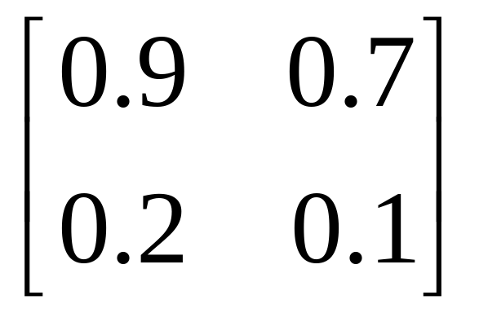
Fuzzy Relations as a Matrix
A relation can also be represented as –
pie
candy
chocolate
M_{R} =
strawberry

Slide 93
Application of Fuzzy Sets
Computational Linguistics
  Calculate natural language statements in the same way as logic statements.
  Uses fuzzy sets and linguistic variables(quantifies the meaning of NL)
  Normally used in heuristic rules.
Linguistic Variable | Typical Values
Height | Dwarf, short, average, tall, giant
Number | Almost, none, several, many, few
Stage of life | Infant, toddler, child, teenager, adult
Light | Dim, faint, normal, bright, intense

Slide 94
Heuristic Rules using Linguistic Variables
If sound is too low then turn up the volume.
The term-set, T(L), of a linguistic variable L is the set of values that it can take.
T(pie) = chocolate+apple+strawberry
Each value may be the union of other sets.
Chocolate= semi-sweet chocolate + milk chocolate+dark chocolate
LV
LV value
LV value
LV

Slide 95
Hedging
A hedge is a quantifier used to modify the meaning of a set.
Example,
chocolate=very chocolate + very very chocolate + more or less chocolate + not very chocolate + …….

Slide 96
Some Standard Linguistic Hedges and Operators
Hedge | Operator Definition
Very F | CON(F)=F²
More or Less F | DIL(F) = F^{0.5}
Plus F | F^{1.25}
Not F | 1-F
Not very F | 1-CON(F)
Slightly F | INT[NORM(PLUS F and NOT (VERY F))
Extremely F | F³
Indeed | 2F² if 0<= F<=0.5 1-2[1-F]² if 0.5<F <=1

Slide 97
Fuzzy Rules with an example
Image | Missile | Fighter | Airline
1 | 1.0 | 0 | 0
2 | 0.9 | 0 | 0.1
3 | 0.4 | 0.3 | 0.2
4 | 0.2 | 0.3 | 0.5
5 | 0.1 | 0.2 | 0.7
6 | 0.1 | 0.6 | 0.4
7 | 0 | 0.7 | 0.2
8 | 0 | 0 | 1
9 | 0 | 0.8 | 0.2
10 | 0 | 1 | 0
Membership grades for images in fuzzy sets for missiles, airline and fighter

Slide 98
Rule1 : If Image4 then target (.2/M+.3/F+.5/A)
Rule 2: If Image6 then target (.1/M+.6/F+.4/A)
So, target = .2/M+.3/F+.5/A + .1/M+.6/F+.4/A
= .2/M + .6/M +.5/A
Most likely that the target is a missile.

Slide 99
In general, for N observations
IF E1 THEN H1
IF E2 THEN H2
……..
IF EN THEN HN
Where all Hi bears on some common hypothesis H, then
μ_{H} = max(μ_{H1,}μ_{H2, ……..} μ_{HN} )

Slide 100
Min-Max Composition Rule of Inference
IF E11 and E12 then H1
IF E21 and E22 then H2
……………………………..
IF En1 and En2 then Hn
μ_{H} = max(min(μ_{E11,} μ_{E12}), min(μ_{E21,} μ_{E22}),…min(μ_{En1,} μ_{En2}))

